Slide 1
Ctrlr code structure
The objective of this document is to describe the different source files of Ctrlr and their dependencies in order to understand the structure
Each page is focusing on a particular topic
Row numbers are provided as an indication only. They may change due to code change but gives an idea on where a certain section is located in long source code files

Slide 2
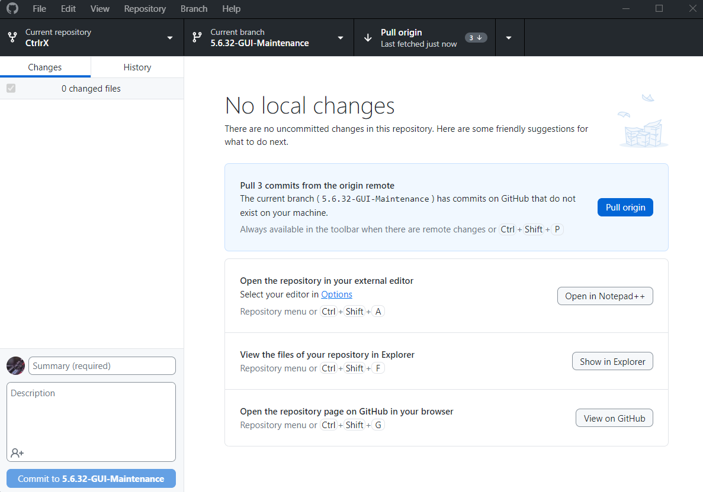
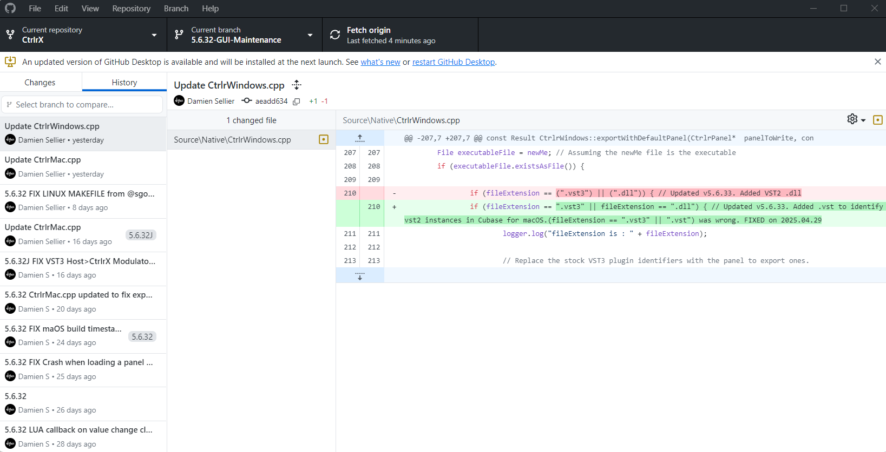
Build process (1/2)
If not yet done,
download Github Desktop from https://desktop.github.com/download/
Clone the CtrlrX repository to a local My_CtrlrX_Folder
Fetch and Pull the latest changes
When a Github repository is cloned to a local repository on your computer, it is possible to Fetch and Pull changes done by others and to Push changes made by you
After Fetch and before Pull
After Pull, the 3 last changes are visible...
In My_CtrlrX_Folder/Source/Misc/boost, expand Boost.zip to have its content in /boost/boost

Slide 3
Build process (2/2)
If not yet done,
Download the JUCE version that is used in the CtrlrX downloaded code from https://github.com/juce-framework/JUCE/releases
Use Projucer from that JUCE version
Set some parameters
Windows | MacOS
Delete the temporary build files for your IDE (Xcode / Visual Studio)
Launch your IDE from Projucer
This is needed each time that for example the Ctrlr IDs are changed
Adapt some Build parameters
Compile and Build
Executable can be found in xxx

Slide 4
Startup
5,3,201: setDefaults (CtrlrProperties)
CtrlrManager.cpp in Core
CtrlrEditor.cpp in Source – UIComponents – CtrlrApplicationWindow
CtrlrAbout.cpp in Source – UIComponents
Creates a CtrlrEditor object with
MenuBarComponent
CommandManager
CtrlrDocumentpanel
Resizer (only for plugin non restricted instances)
getActivePanel() returns true if any
Set LnF to v3 if Legacy mode is ON otherwise, v4
ctrlrMidiDeviceManager
ctrlrDocumentPanel
ctrlrWindowManager
CtrlrPanelWindowManager
case showAboutDialog:
owner.getWindowManager().showModalDialog ("Ctrlr/About", ScopedPointer <CtrlrAbout> (new CtrlrAbout(owner)), false, this);
break;
Each active panel has its window manager.
CtrlrEditorApplicationCommandsHandler contains the actions to perform for each command associated to a Ctrlr menu item (defined in CtrlrEditorApplicationCommandMenus.cpp)
Check what getCommandInfo is doing
new CtrlrAbout component (defined in CtrlrAbout.h which is included in CtrlrEditorApplicationCommandsHandler.cpp
#include "CtrlrEditor.h"
#include "CtrlrAbout.h"
#include "CtrlrPanel/CtrlrPanel.h"
#include "CtrlrPanel/CtrlrPanelEditor.h"
#include "CtrlrMIDILibrary/CtrlrMIDILibrary.h"
#include "CtrlrWindowManagers/CtrlrDialogWindow.h"
#include "CtrlrMIDI/CtrlrMIDISettingsDialog.h"
CtrlrLuaMethodEditor.cpp in UIComponents – CtrlrLua - MethodEditor
CtrlrPanelWindowManager::LuaMethodEditor

Slide 5
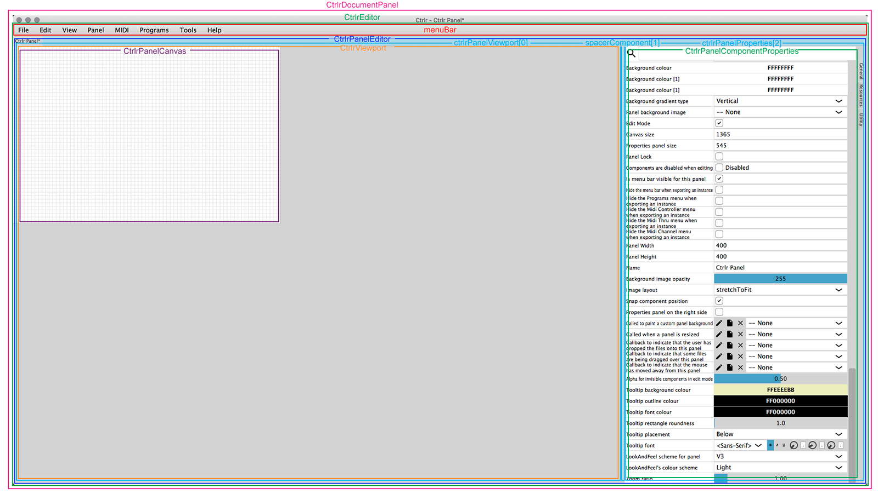
Picture from Damien. I think that CtrlrEditor and CtrlrDocumentPanel are inverted. TBC
Application structure

Slide 6
Ctrlr application properties
CtrlrProperties.h in Core
CtrlrProperties.cpp in Core
Handling of the .settings file

Slide 7
About
CtrlrAbout.h in Core
CtrlrAbout.cpp in Core
Handling of the .settings file
!! To check possibility to display some properties from the panel in the About window !!
This was in 5.3.201 (instance). Still in 5.6.34?

Slide 8
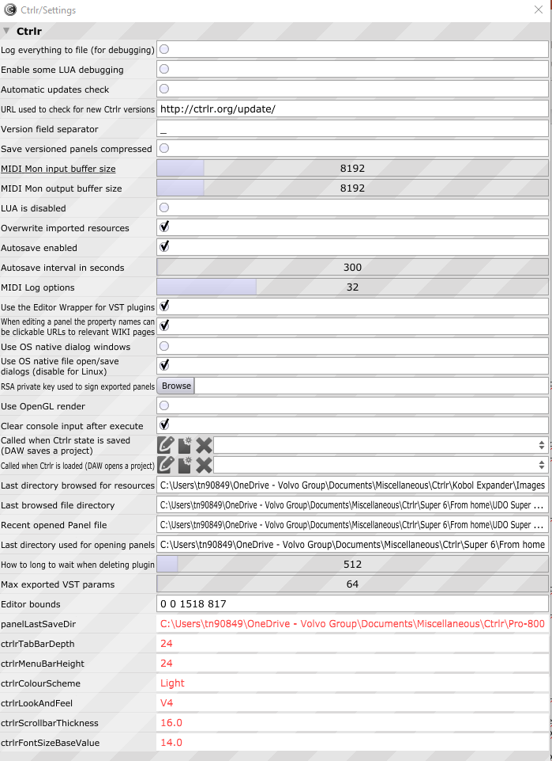
Don’t know where the order is specified...
Ctrlr Preferences
CtrlrSettings.h in UIComponents - CtrlrApplicationWindow
Display and fill of the Ctrlr Preferences popup
CtrlrSettings.cpp in UIComponents - CtrlrApplicationWindow
<!-- Global Ctrlr settings -->
<id name="ctrlrMaxExportedVstParameters" text="Max exported VST params" type="Numeric" min="0" max="999999" int="1" />
<id name="ctrlrLogToFile" text="Log everything to file (for debugging)" type="Bool" />
CtrlrIDs.xml in Resources - XML
DECLARE_ID (ctrlrEditorBounds);
DECLARE_ID (ctrlrMaxExportedVstParameters);
DECLARE_ID (ctrlrShutdownDelay);
DECLARE_ID (ctrlrUseEditorWrapper);
DECLARE_ID (ctrlrVersionSeparator);
DECLARE_ID (ctrlrVersionCompressed);
DECLARE_ID (ctrlrMidiMonInputBufferSize);
DECLARE_ID (ctrlrMidiMonOutputBufferSize);
DECLARE_ID (ctrlrLogMidiInput);
DECLARE_ID (ctrlrLogMidiOutput);
DECLARE_ID (ctrlrLogOptions);
DECLARE_ID (ctrlrLuaDisabled);
DECLARE_ID (ctrlrLastBrowsedResourceDir);
DECLARE_ID (ctrlrLogToFile);
DECLARE_ID (ctrlrLuaDebug);
DECLARE_ID (ctrlrOverwriteResources);
DECLARE_ID (ctrlrAutoSave);
DECLARE_ID (ctrlrAutoSaveInterval);
DECLARE_ID (ctrlrLastBrowsedFileDirectory);
DECLARE_ID (ctrlrOpenWindowState);
DECLARE_ID (ctrlrRecenetOpenedPanelFiles);
DECLARE_ID (ctrlrPropertiesAreURLs);
DECLARE_ID (ctrlrKeyboardMapping);
DECLARE_ID (ctrlrCapabilities);
DECLARE_ID (ctrlrLastMenuItemId);
DECLARE_ID (ctrlrNativeAlerts);
DECLARE_ID (ctrlrNativeFileDialogs);
DECLARE_ID (ctrlrMenuItemBackgroundColour);
DECLARE_ID (ctrlrMenuItemTextColour);
DECLARE_ID (ctrlrMenuItemHighlightedTextColour);
DECLARE_ID (ctrlrMenuItemHighlightColour);
DECLARE_ID (ctrlrMenuItemFont);
DECLARE_ID (ctrlrMenuItemSeparatorColour);
DECLARE_ID (ctrlrMenuItemHeaderColour);
Definitions of all properties and their type
name
text
type
...
CtrlrIDs.h in Core
DECLARE_ID (each_property_name)
New ones in 5.6.30?
DECLARE_ID (ctrlrMenuBarBackgroundColour1);
DECLARE_ID (ctrlrMenuBarBackgroundColour2);
DECLARE_ID (ctrlrMenuBarTextColour);
DECLARE_ID (ctrlrMenuBarHeight);
DECLARE_ID (ctrlrMenuBarHighlightedTextColour);
DECLARE_ID (ctrlrMenuBarHighlightColour);
DECLARE_ID (ctrlrMenuBarFont);
DECLARE_ID (ctrlrPrivateKey);
DECLARE_ID (ctrlrFontSizeBaseValue);
DECLARE_ID (ctrlrScrollbarThickness);
DECLARE_ID (ctrlrColourScheme);
DECLARE_ID (ctrlrLookAndFeel);
DECLARE_ID (ctrlrTabBarDepth);

Slide 9
Ctrlr Look and Feel (1/2)
TO BE ADAPTED TO NEW WAY TO CREATE V4 THEMES
Juce_LookAndFeel_V2.cpp in JUCE Modules – juce_gui_basics - lookandfeel
All colours for each type of component in v2 and v3
Juce_LookAndFeel_V3.cpp in JUCE Modules – juce_gui_basics - lookandfeel
StretchableLayoutResizerBar: g.fillAll (Colours::yellow.withAlpha (0.4f));
Juce_LookAndFeel_V4.cpp in JUCE Modules – juce_gui_basics - lookandfeel
LookAndFeel_V4::ColourScheme LookAndFeel_V4::getYamDxColourScheme() // Added for CtrlrX v5.6.30
{
return { 0xff0b0b0b, 0xff0f0f0f, 0xff111111,
0xff666666, 0xfffffbed, 0xff29cfc1,
0xffffffff, 0xff8584bc, 0xfffffdf2 };
}
Colours for each V4 ColourSchemes
windowBackground, widgetBackground, menuBackground,
outline, defaultText, defaultFill,
highlightedText, highlightedFill, menuText
Juce_LookAndFeel_V4.h in JUCE Modules – juce_gui_basics - lookandfeel
static ColourScheme getDarkColourScheme();
static ColourScheme getMidnightColourScheme();
static ColourScheme getGreyColourScheme();
static ColourScheme getLightColourScheme();
static ColourScheme getJetBlackColourScheme(); // Added for CtrlrX v5.6.30
static ColourScheme getYamDxColourScheme(); // Added for CtrlrX v5.6.30
static ColourScheme getAkApcColourScheme(); // Added for CtrlrX v5.6.30
static ColourScheme getAkMpcColourScheme(); // Added for CtrlrX v5.6.30
static ColourScheme getLexiBlueColourScheme(); // Added for CtrlrX v5.6.30
static ColourScheme getKurzGreenColourScheme(); // Added for CtrlrX v5.6.30
static ColourScheme getKorGreyColourScheme(); // Added for CtrlrX v5.6.30
static ColourScheme getKorGoldColourScheme(); // Added for CtrlrX v5.6.30
static ColourScheme getArturOrangeColourScheme(); // Added for CtrlrX v5.6.30
static ColourScheme getAiraGreenColourScheme(); // Added for CtrlrX v5.6.30
Structure and declarations of V4 ColourSchemes
CtrlrIDs.xml in Source - Resources - XML
<const name="componentlookandfeel" value="Default,V4 Light,V4 Grey,V4 Dark,V4 Midnight,V4 JetBlack,V4 YamDX,V4 AkAPC,V4 AkMPC,V4 LexiBlue,V4 KurzGreen,V4 KorGrey,V4 KorGold,V4 ArturOrange,V4 AiraGreen,V3,V2,V1" />
<const name="lookandfeelschemes" value="V4 Light,V4 Grey,V4 Dark,V4 Midnight,V4 JetBlack,V4 YamDX,V4 AkAPC,V4 AkMPC,V4 LexiBlue,V4 KurzGreen,V4 KorGrey,V4 KorGold,V4 ArturOrange,V4 AiraGreen,V3,V2,V1" />
<const name="ctrlrColourSchemes" value="Light,Grey,Dark,Midnight,JetBlack,YamDX,AkAPC,AkMPC,LexiBlue,KurzGreen,KorGrey,KorGold,ArturOrange,AiraGreen" />
ColourSchemes constants
!! Any modification of CtrlrIDs.xml requires deleting the temporary files in Builds/VisualStudio2022 and remaking them from the Projucer

Slide 10
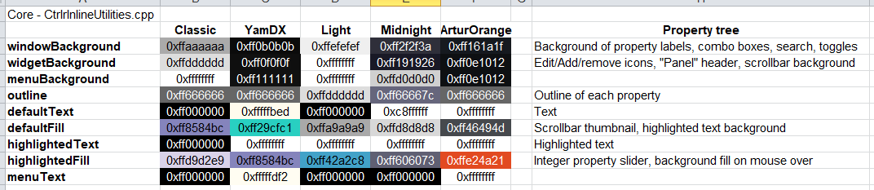
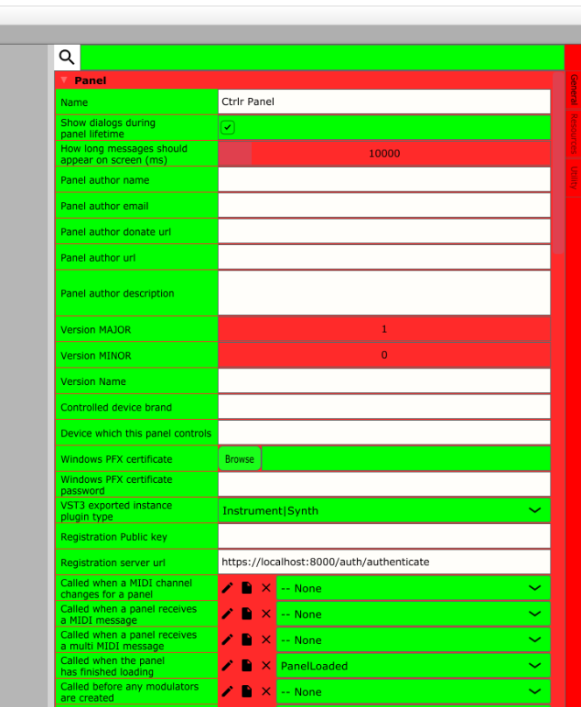
Ctrlr Look and Feel (2/2)
CtrlrInlineUtilities.cpp in Core
Colours for some V4 ColourSchemes
Green: widgetBackground Red: windowBackground
juce::LookAndFeel_V4::ColourScheme getClassicColourScheme() // Added for CtrlrX v5.6.34 by @dobo365 DB
{
return { 0xffaaaaaa, 0xffdddddd, 0xffffffff,
0xff666666, 0xff000000, 0xff8584bc,
0xff000000, 0xffd9d2e9, 0xff000000 };
}

Slide 11
!! In Juce_LookAndFeel_V2.h and in Juce_LookAndFeel_V2.cpp, there is LookAndFeel_V2::createAlertWindow and LookAndFeel_V2:: drawAlertBox with the correct colors In Juce_LookAndFeel_V4.cpp, LookAndFeel_V2::createAlertWindow seems to refer to LookAndFeel_V4::createAlertWindow
AlertWindows
CtrlrLuaUtils.cpp in Source – Lua
The 4 types of AlertWindows available in Ctrlr (question, warning, info, askForTextInput)
Juce_AlertWindow.cpp in JUCE Modules – juce_gui_basics - windows
Code for high level AlertWindows (warning, question, info) based on the abstract base class AlertWindow
Code for the drawing of invidual objects within an AlertWindow (buttons, combo, text editor...)
Juce_ AlertWindow.h in JUCE Modules – juce_gui_basics - windows
Declarations for the above
Colors are set by V4 scheme but where is this applied when changed in the GUI? Create new “legacy” scheme? OR force legacy colors
Juce_LookAndFeel_V4.cpp in JUCE Modules – juce_gui_basics - lookandfeel
AlertWindow* LookAndFeel_V4::createAlertWindow (const String& title, const String& message,
const String& button1, const String& button2, const String& button3,
AlertWindow::AlertIconType iconType,
int numButtons, Component* associatedComponent)
void LookAndFeel_V4::drawAlertBox (Graphics& g, AlertWindow& alert,
const Rectangle<int>& textArea, TextLayout& textLayout)
Colours for each V4 ColourSchemes + All other colors
Code for abstract base class AlertWindow
AlertWindow::backgroundColourId, currentColourScheme.getUIColour (ColourScheme::UIColour::widgetBackground).getARGB(),
AlertWindow::textColourId, currentColourScheme.getUIColour (ColourScheme::UIColour::defaultText).getARGB(),
AlertWindow::outlineColourId, currentColourScheme.getUIColour (ColourScheme::UIColour::outline).getARGB(),
Juce_LookAndFeel_V4.h in JUCE Modules – juce_gui_basics - lookandfeel
AlertWindow* createAlertWindow (const String& title, const String& message,
const String& button1,
const String& button2,
const String& button3,
AlertWindow::AlertIconType iconType,
int numButtons, Component* associatedComponent) override;
void drawAlertBox (Graphics&, AlertWindow&, const Rectangle<int>& textArea, TextLayout&) override;
int getAlertWindowButtonHeight() override;
Font getAlertWindowTitleFont() override;
Font getAlertWindowMessageFont() override;
Font getAlertWindowFont() override;
Structure and declarations of V4 ColourSchemes
Declarations for abstract base class AlertWindow
Changed to windowBackground

Slide 12
Panel editor
CtrlrPanel.cpp in Core - CtrlrPanel
Initialization of panel properties (panel including Midi settings)
CtrlrDocumentPanel.cpp in UIComponent - CtrlrApplicationWindow
Panel …
CtrlrPanelProperties.cpp in UIComponent - CtrlrPanel
Right vertical tabs (General, Resources, Utility)
CtrlrPanelComponentProperties.cpp in UIComponent - CtrlrPanel
CtrlrPanelResourceEditor.cpp in UIComponent - CtrlrPanel
CtrlrPanelUtilities.cpp in UIComponent - CtrlrPanel
Fill the content of the General tab
Fill the content of the Resources tab
Fill the content of the Utility tab

Slide 13
All object properties
CtrlrPropertyComponent.h in UIComponents - CtrlrPropertyEditors
CtrlrBooleanPropertyComponent
CtrlrColourEditorComponent
CtrlrExpressionProperty
CtrlrTextPropertyComponent
...
Definitions of all Property components types visible in the Property table
CtrlrIDs.xml in Resources - XML
CtrlrIDs.h in Core
name
text
type
...
Definitions of all properties and their type
DECLARE_ID (each_property_name)
CtrlrPropertyComponent.cpp in UIComponents - CtrlrPropertyEditors
Draw and fill-in each property in the Property table
CtrlrIDManager.h in Core
CtrlrIDManager.cpp in Core
Called by?
Look and feel of the total Property table and of each property
type
ReadOnly: modulatorValue
Bool: modulatorMute
Text: panelVendor
VarText: panelMidiInputDevice (list)
Numeric: panelVersionMajor
VarNumeric: panelMidiInputChannelDevice (list)
Colour: uiPanelTooltipColour
Font: uiPanelTooltipFont
MultiLineSmall:
MultiLine: uiListBoxContent
LuaMethod: componentLuaMouseDown
Sysex: ActionButton:
Timestamp:
ModulatorList:
MultiMidi:
Expression:
FileProperty:
UnkownProperty:
Load properties from CtrlrIDs.xml in different ValueTree
preferredHeight for each property
Row 86: visibleText for the labels (name or text), conversion of property type from CtrlrIDs.xml to the below components
Row 240: CtrlrBooleanPropertyComponent
Row 288: CtrlrButtonPropertyComponent ? Like Add Tab ?
Row 314: CtrlrChoicePropertyComponent (combo box like ?)
Row 406: CtrlrColourEditorPropertyComponent
Row 507: CtrlrReadOnlyProperty
Row 534: CtrlrExpressionProperty
Row 626: CtrlrFileProperty
Row 679: CtrlrFontPropertyComponent
Row 846: CtrlrLuaMethodProperty
Row 962: CtrlrModulatorListProperty
Row 1043: CtrlrMultiMidiPropertyComponent
Row 1289: CtrlrSliderPropertyComponent
Row 1328: CtrlrSysexEditor
Row 1690: CtrlrSysexFormulaEditor
Row 1778: CtrlrSysexPropertyComponent
Row1896: CtrlrTextPropLabel
Row 1940: CtrlrTextPropertyComponent
Row 2001: CtrlrTimeStampProperty
Row 2026: CtrlrUnknownPropertyComponent
Called by?
<id name="panelVersionMajor" text="Version MAJOR" type="Numeric" min="0" max="2048" int="1" />

Slide 14
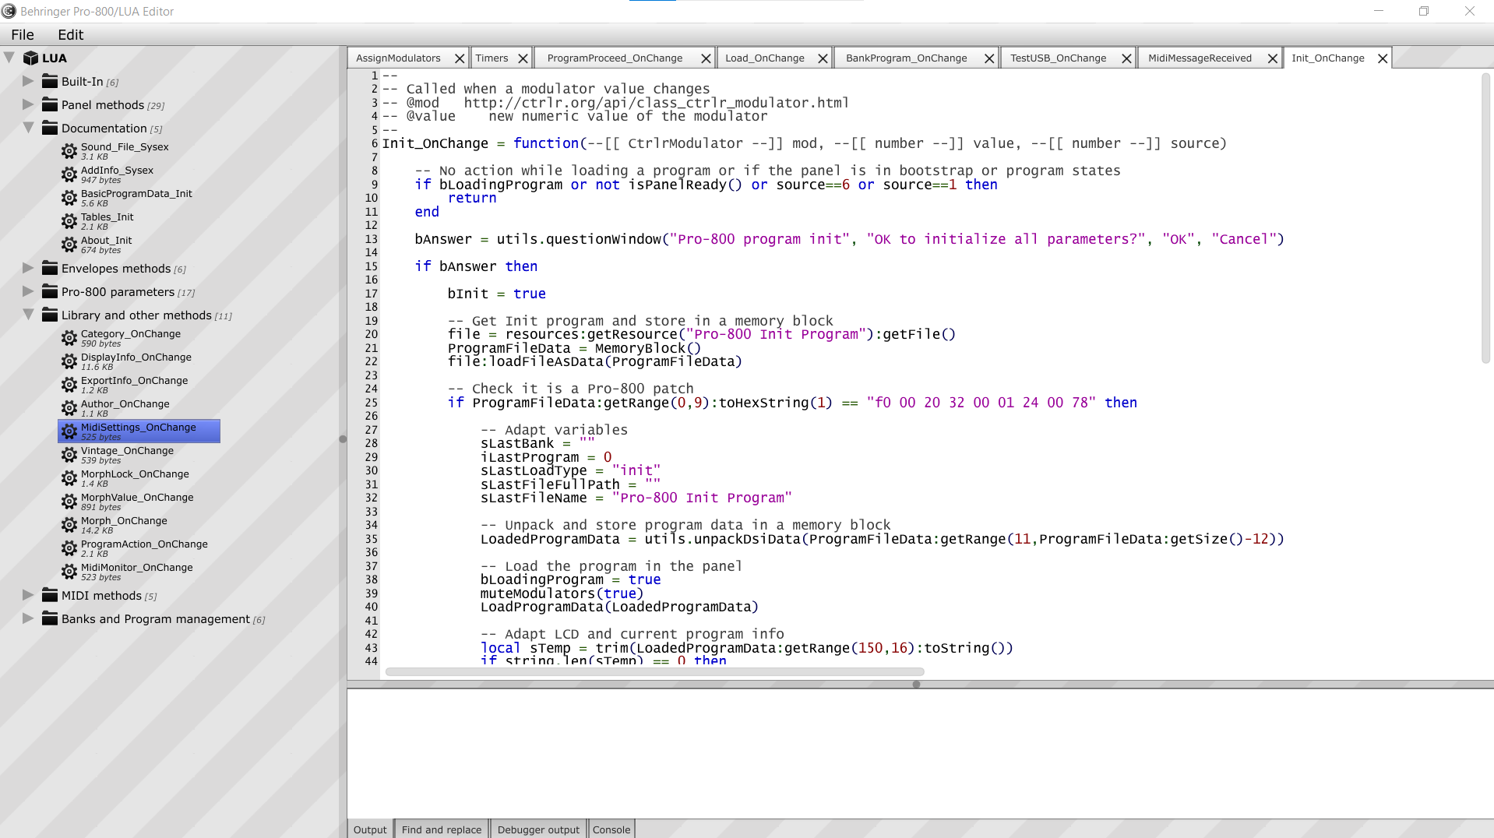
Draw the Lua Editor with its 3 zones and contains all the functions to manage the methods in the method tree (menu bar, create, delete, drag and drop...) and the tabs of the different methods
Lua editor
CtrlrLuaMethodEditor.cpp in UIComponents – CtrlrLua - MethodEditor
LuaMethodEditor
methodEditArea -> upperTabs
resizer
CtrlrLuaMethodCodeEditor.cpp in UIComponents – CtrlrLua - MethodEditor
Line numbers bar Display and handling of the code
CtrlrLuaMethodCodeTokeniser.cpp in UIComponents – CtrlrLua - MethodEditor
Code analyzer and colouring
methodEditArea
methodTree
methodEditArea -> resizer
CtrlrLuaMethodEditArea.cpp in UIComponents – CtrlrLua - MethodEditor
Draw the whole method edit area and manage the bottom tabs
methodEditArea -> lowerTabs

Slide 15
Lua editor – Look and Feel
Juce_LookAndFeel_V3.cpp in JUCE Modules – juce_gui_basics - lookandfeel
Resizer color
StretchableLayoutResizerBar: g.fillAll (Colours::yellow.withAlpha (0.4f));
CtrlrLuaCodeTokeniser.cpp in UIComponents – CtrlrLua - MethodEditor
Colors according to the type of word
Comment is 0xff3c3c3c (grey)
Can be changed to 0xff4da63a (green) or 0xff888888
CtrlrLuaMethodCodeEditor in UIComponents – CtrlrLua - MethodEditor
Colors of the Code editor
backgroundColourId
defaultTextColourId
lineNumberBackgroundId
lineNumberTextId
highlightColourId
Juce_LookAndFeel_V4.cpp in JUCE Modules – juce_gui_basics - lookandfeel
Colours for each V4 ColourSchemes + All other colors
CtrlrLuaMethodEditArea.cpp in UIComponents – CtrlrLua - MethodEditor
Colors of the method edit area (bottom tabs...)
CtrlrValueTreeEditor.cpp in UIComponents
Drawing of rectangle and color of the selected method
CtrlrInlineUtilitiesGUI.cpp in UIComponents
drawSelectionRectangle(Graphics &g, int width, int height, Colour base = Colour(HIGHLIGHT_COLOUR),
const float baseSaturation = 0.9f, const float baseAlpha = 0.9f,
const float gradientMin = 0.2f, const float gradientMax = 0.25f)
CtrlrMacros.h in Core
#define HIGHLIGHT_COLOUR 0xff4364ff

Slide 16
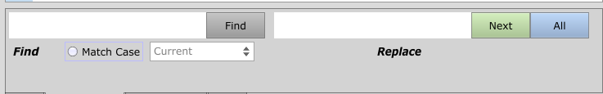
Lua editor - Method edit area
Draw the whole method edit area
Create and manage the bottom tabs
Manage the Output tab
CtrlrLuaMethodEditArea.cpp in UIComponents – CtrlrLua - MethodEditor
CtrlrLuaMethodFind.cpp in UIComponents – CtrlrLua - MethodEditor
Draw and manage the Find and replace tab
Ctrl-F popup is managed in CtrlrLuaMethodCodeEditor.cpp in UIComponents – CtrlrLua – MethodEditor (similar code but not exactly the same)
Find in Open methods / Find in All methods Find results displayed in Find and replace tab are calling searchResultClicked in CtrlrLuaMethodCodeEditor.cpp when double clicked
CtrlrLuaMethodEditorConsole.cpp in UIComponents – CtrlrLua - MethodEditor
Draw and manage the Console tab
CtrlrLuaMethodDebuggerXXX.cpp in UIComponents – CtrlrLua - MethodEditor
Draw and manage the Debugger output tab
Keep methods opened after a match

Slide 17
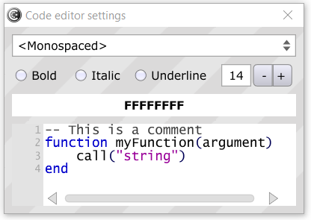
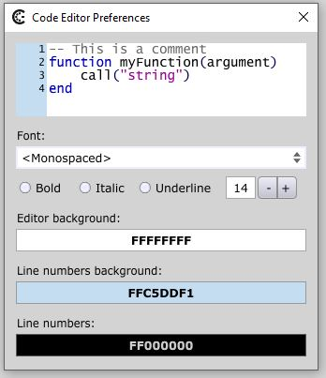
Lua editor - Menu
Draw the Lua Editor with its 3 zones and contains all the functions to manage the methods in the method tree (menu bar, create, delete, drag and drop...) and the tabs of the different methods
CtrlrLuaMethodEditor.cpp in UIComponents – CtrlrLua - MethodEditor
CtrlrLuaCodeEditorSettings.cpp in UIComponents – CtrlrLua - MethodEditor
Draw the Code editor settings window
CtrlrLuaCodeEditorSettings.h in UIComponents – CtrlrLua - MethodEditor
CtrlrIDs.h in Core
DECLARE_ID (each_property_name)
DECLARE_ID (luaMethodEditorFont);
DECLARE_ID (luaMethodEditorBgColour);
DECLARE_ID (luaMethodEditorLineNumbersBgColour); // New
DECLARE_ID (luaMethodEditorLineNumbersColour); // New

Slide 18
Lua editor – Code editor
All actions occuring in the code editor
So, also contains the Ctrl-F, Ctrl-G code The Find code is repeated from the Find and Replace tab but here applied to the Find popup.
CtrlrLuaMethodCodeEditor.cpp in UIComponents – CtrlrLua - MethodEditor

Slide 19
Opening a panel for editing
... in xxx
... in xxx
CtrlrPanel.cpp in Core - CtrlrPanel
CtrlrDocumentPanel.cpp in UIComponents - CtrlrApplicationWindow
CtrlrEditor.cpp in UIComponents - CtrlrApplicationWindow
CtrlrPanelEditor.cpp in UIComponents - CtrlrPanel
CtrlrPanelViewport.cpp in UIComponents - CtrlrPanel
CtrlrViewport.cpp in UIComponents - CtrlrPanel

Slide 20
Open questions...
CtrlrValueTreeEditor.cpp in UIComponents
getItemWidth(), getItemHeight(), paintItem() seem not used by anything in Ctrlr (VS2019: Find all references)
keyPressed() is checking for F2 providing a “Rename method” but doesn’t perform the actual Rename
... in xxx

